Slide 1

building a Tiny Language
Model
Thumidnu ranaisnghe

Slide 2
Problem
Create pairs of letters from names and find probabilities
Create new names based on these probablilities

Slide 3


Key Challenges
Learning the statistics
Split names into pairs
Calculte probablitlityes of letters following
Create new names
Calculate probablitlites of the name

Slide 4
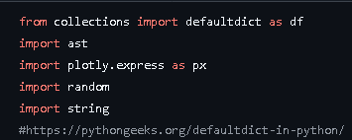
modules
Used for data formatting graph

Slide 5

Querying the list of names

Slide 6
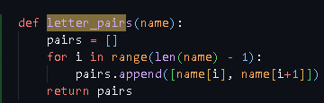
Split name
Creates list
Returns list
Appends it to list
Gets first and next letter

Slide 7
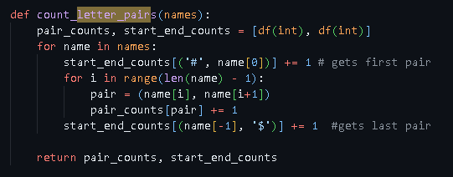
Learning the statistics
Creates blank dictionaries
Finds first and next letter of name
Loops through all names

Slide 8

sorting
Gets each x(0) from a pair and sorts it from ascending order

Slide 9
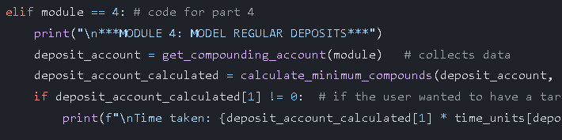
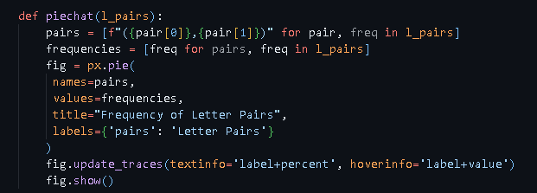
Graph
Sets each name as a pair and the values their frequency
Is interactive

Slide 10

Find pairs starting with
iterating over the pairs list and selecting only the pairs where the first character of the first element in each pair matches the specified letter

Slide 11
Learning the statistics
Creates blank dictionaries
Finds first and next letter of name
Loops through all names

Slide 12

Coin and spinnar
List with all choices
Chooses random choice

Slide 13
Learning the statistics
Creates blank dictionaries
Finds first and next letter of name
Loops through all names

Slide 14
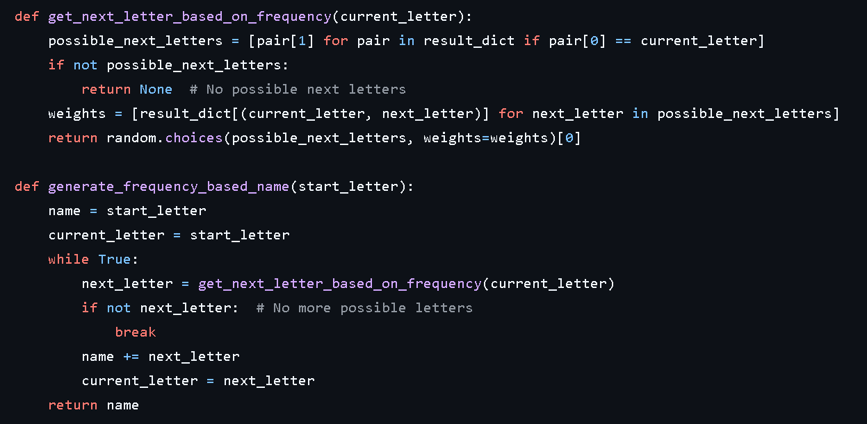
Generate names
Uses similar function to predict the new pairs
Returns a name
Reuses get next letter function for all name generation
The last pair becomes the first pair until it ends with a $

Slide 15
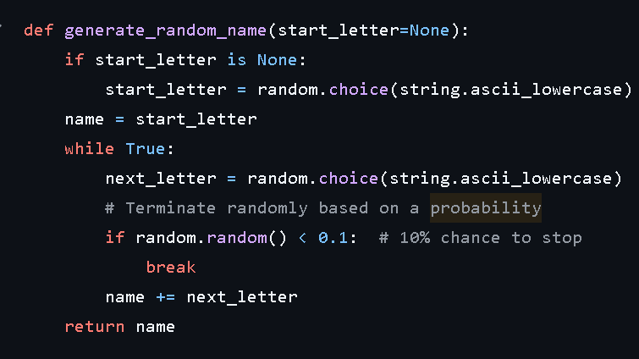
Learning the statistics
Can use with a starting letter for other parts
Chooses a random letter
Puts it all together

Slide 16

Racism in the names
It does not include any tribal African names such as 🏓🏓🏓🗣️🫰🏿🏓
1
This is racism and it is not good
2

Slide 17

code
https://github.com/thumindu007/Y9-CAT-Inv2-Thumindu-Ranasinghe

Slide 18



Tools Used
Github
Powerpoint
ChatGPT

Slide 19
Finished now🐒

